Slide 1





Pulverizers

Slide 2

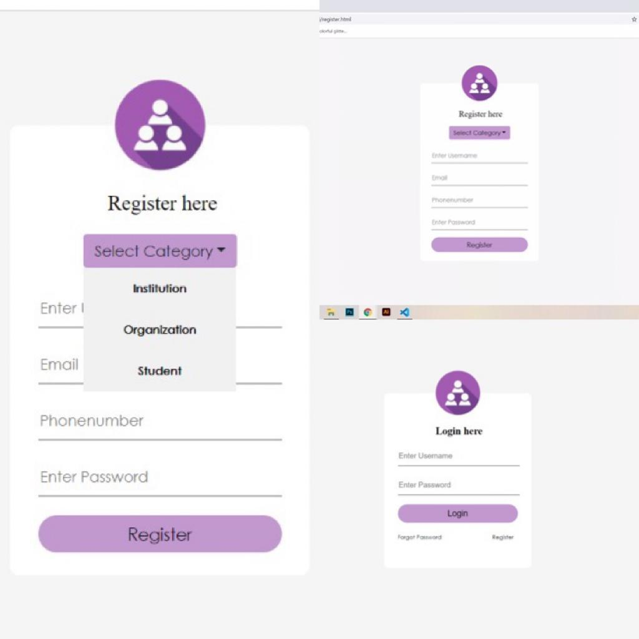
Layout of
Login & Register page
Credentials play a major role in the website design which we make so this is the basic step of our design.

Slide 3

Categories
PART 01
Institution
PART 02
Companies
PART 03
Student

Slide 4


Institutions
The next following pages are displayed when the login users are institute or university heads

Slide 5
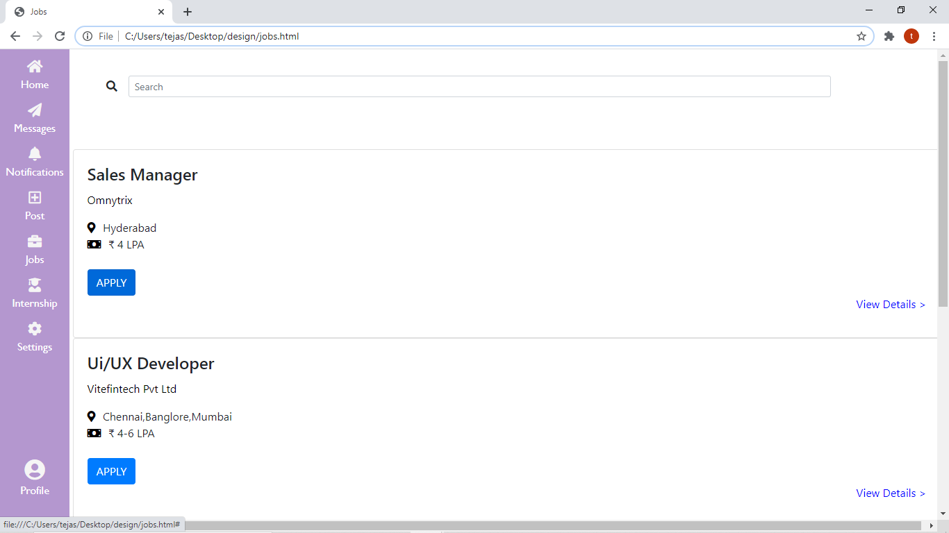
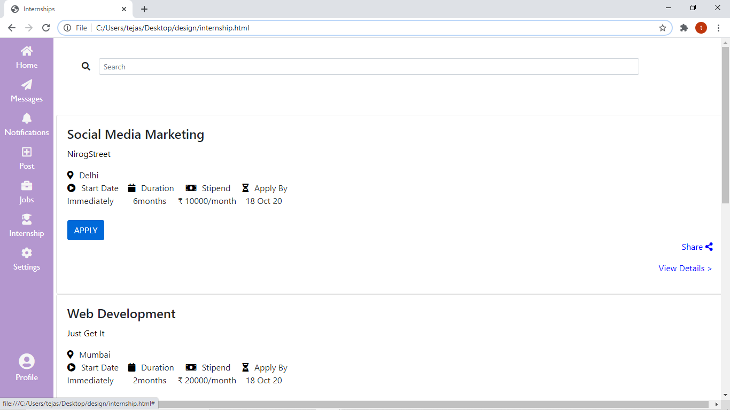
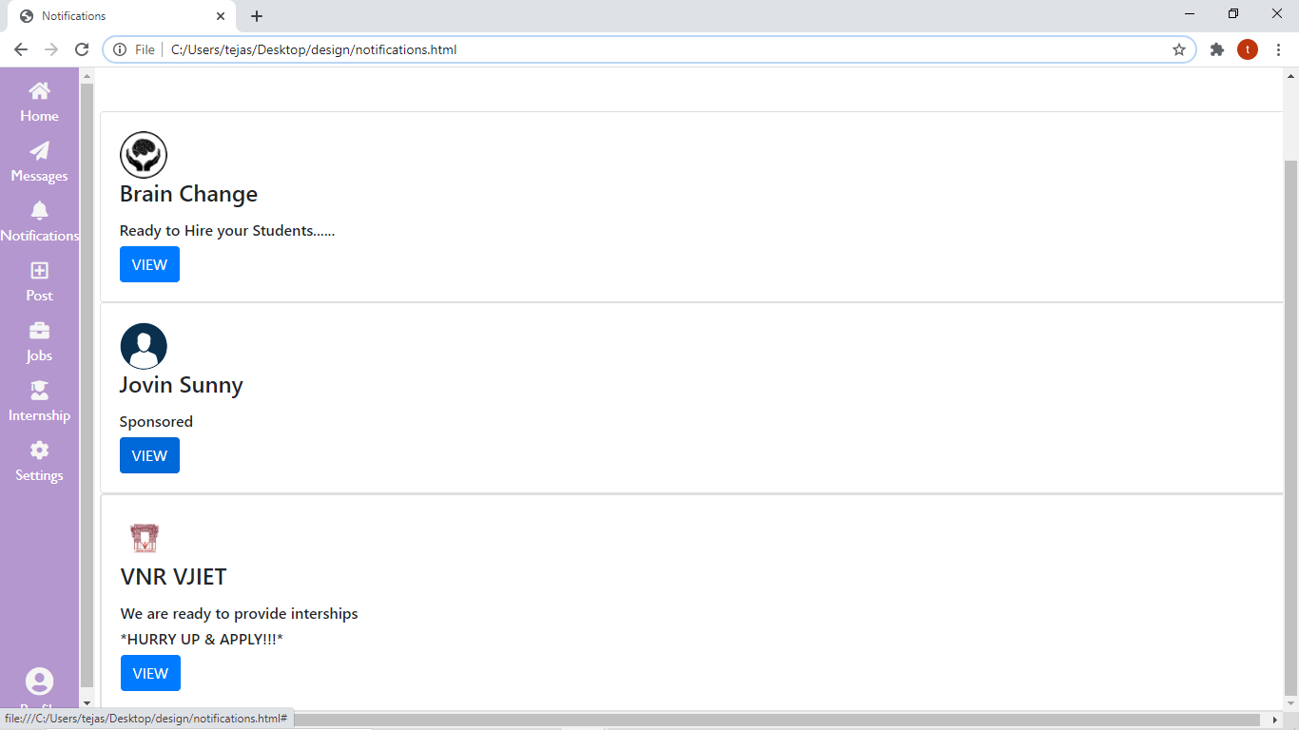
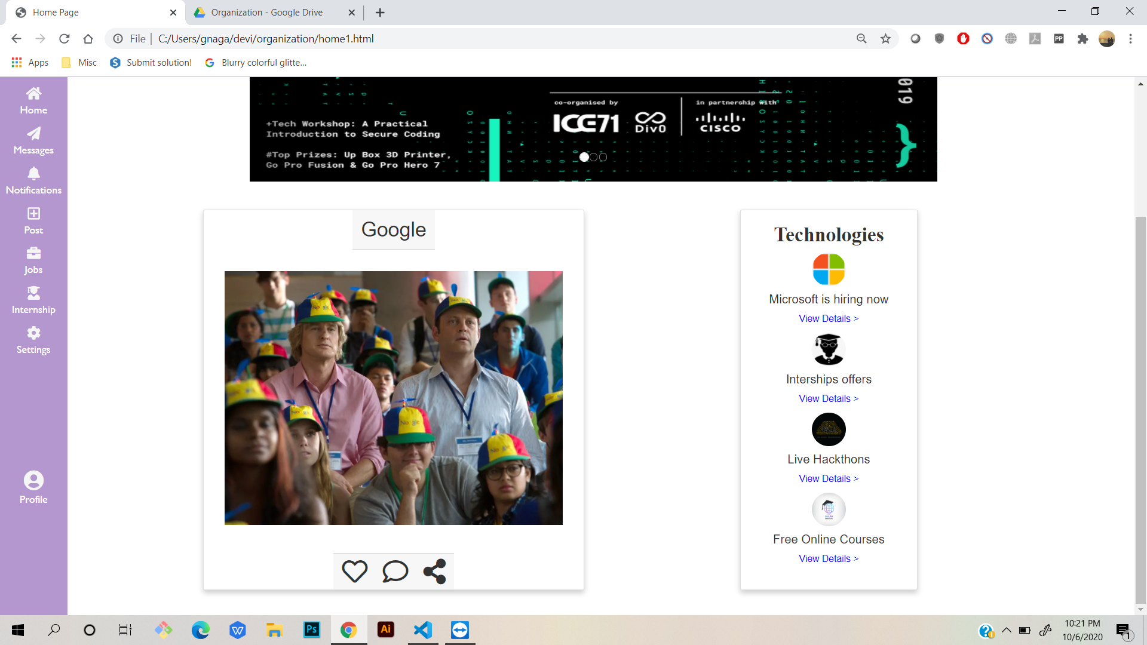
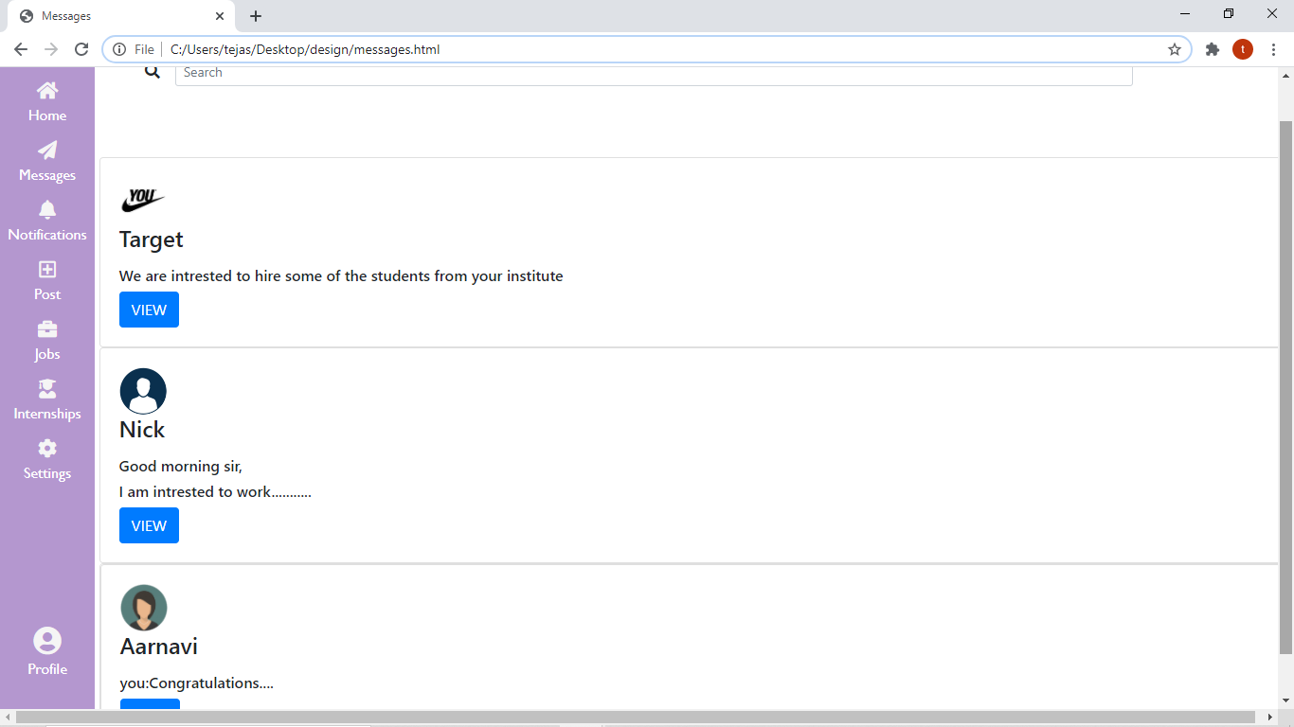
Institutions

Slide 6

Companies
The following pages will be displayed when the login user is some company head and wanna put an internship or job offer for university people.

Slide 7
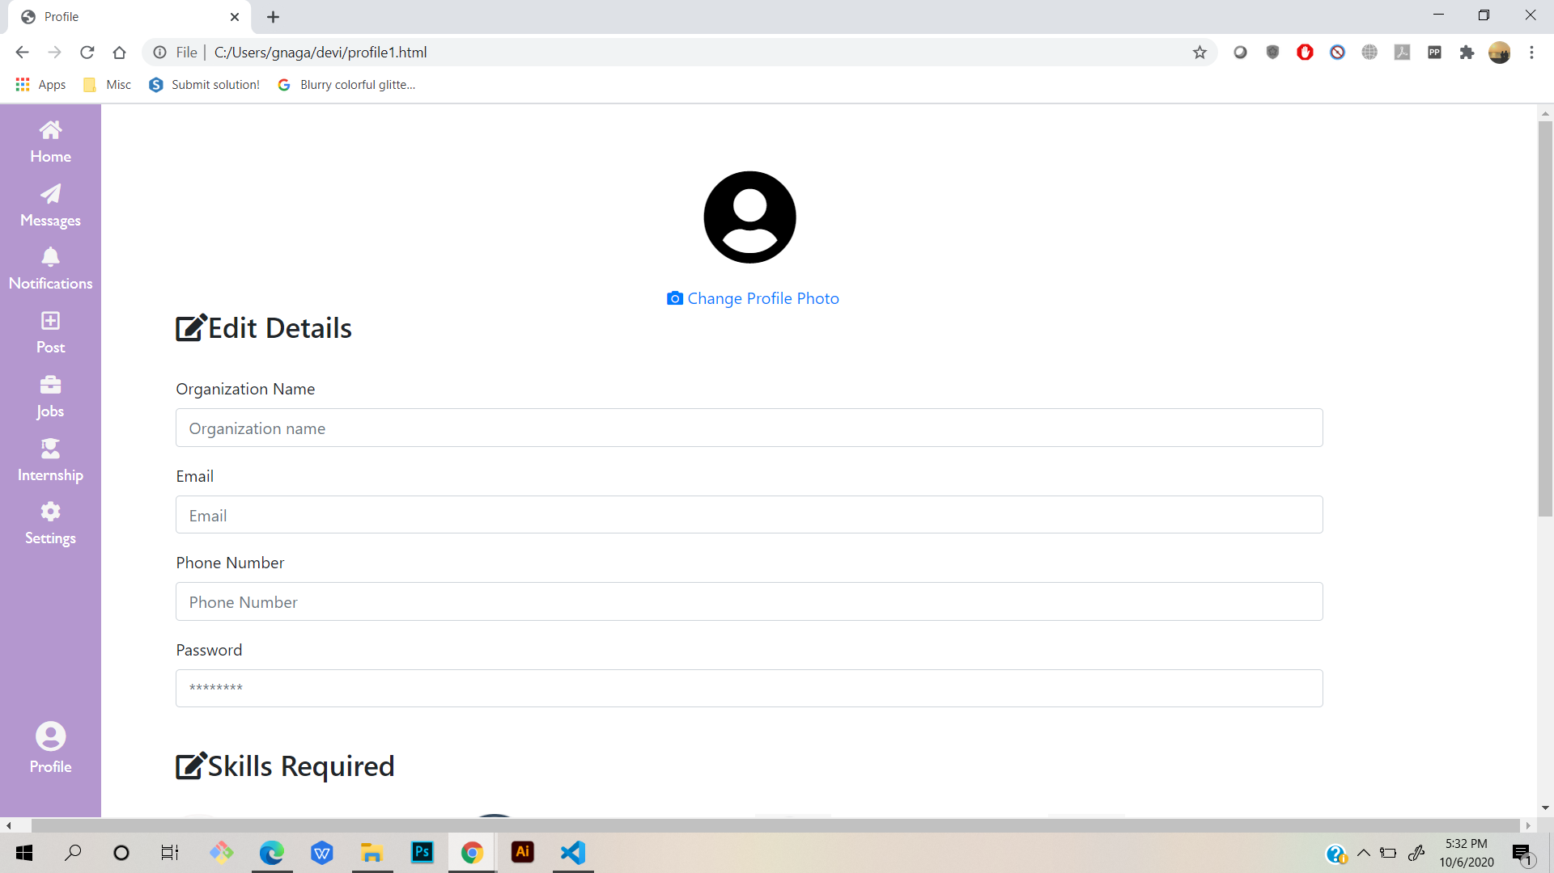
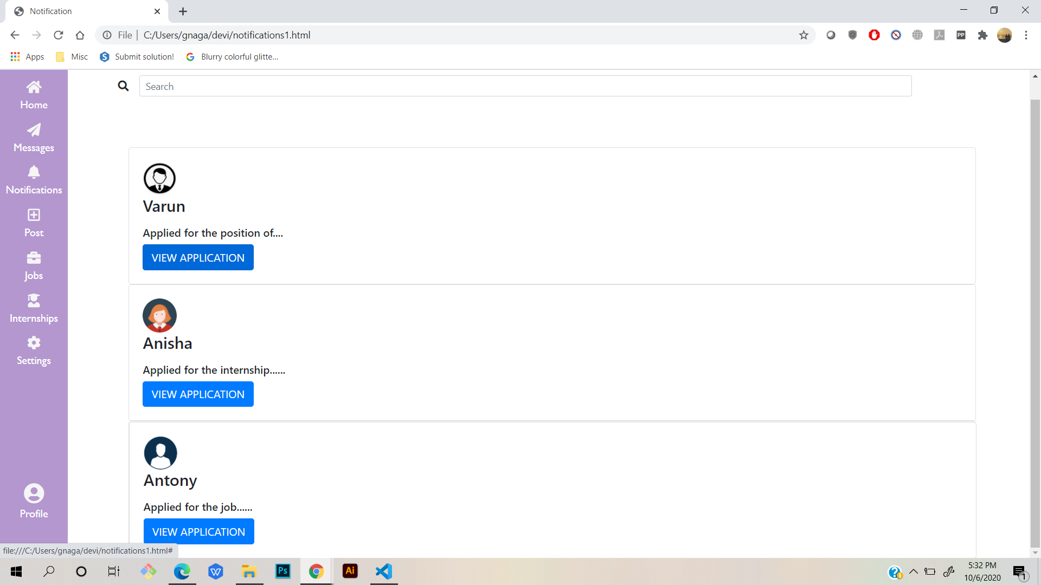
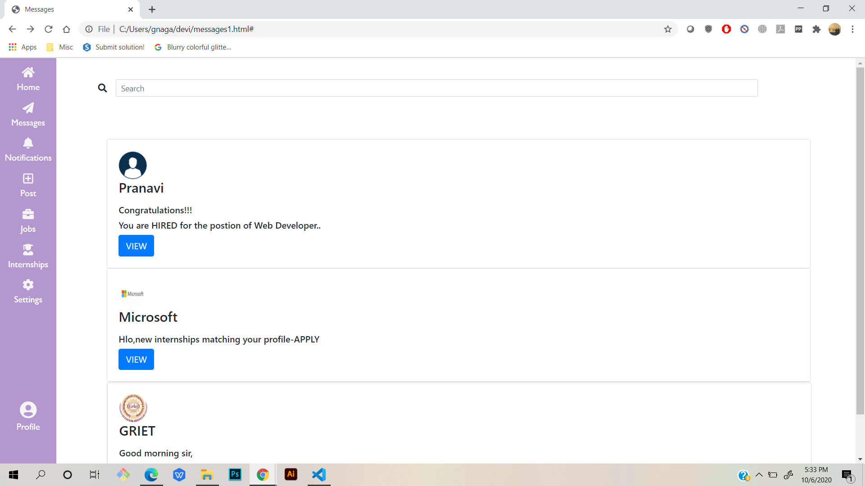
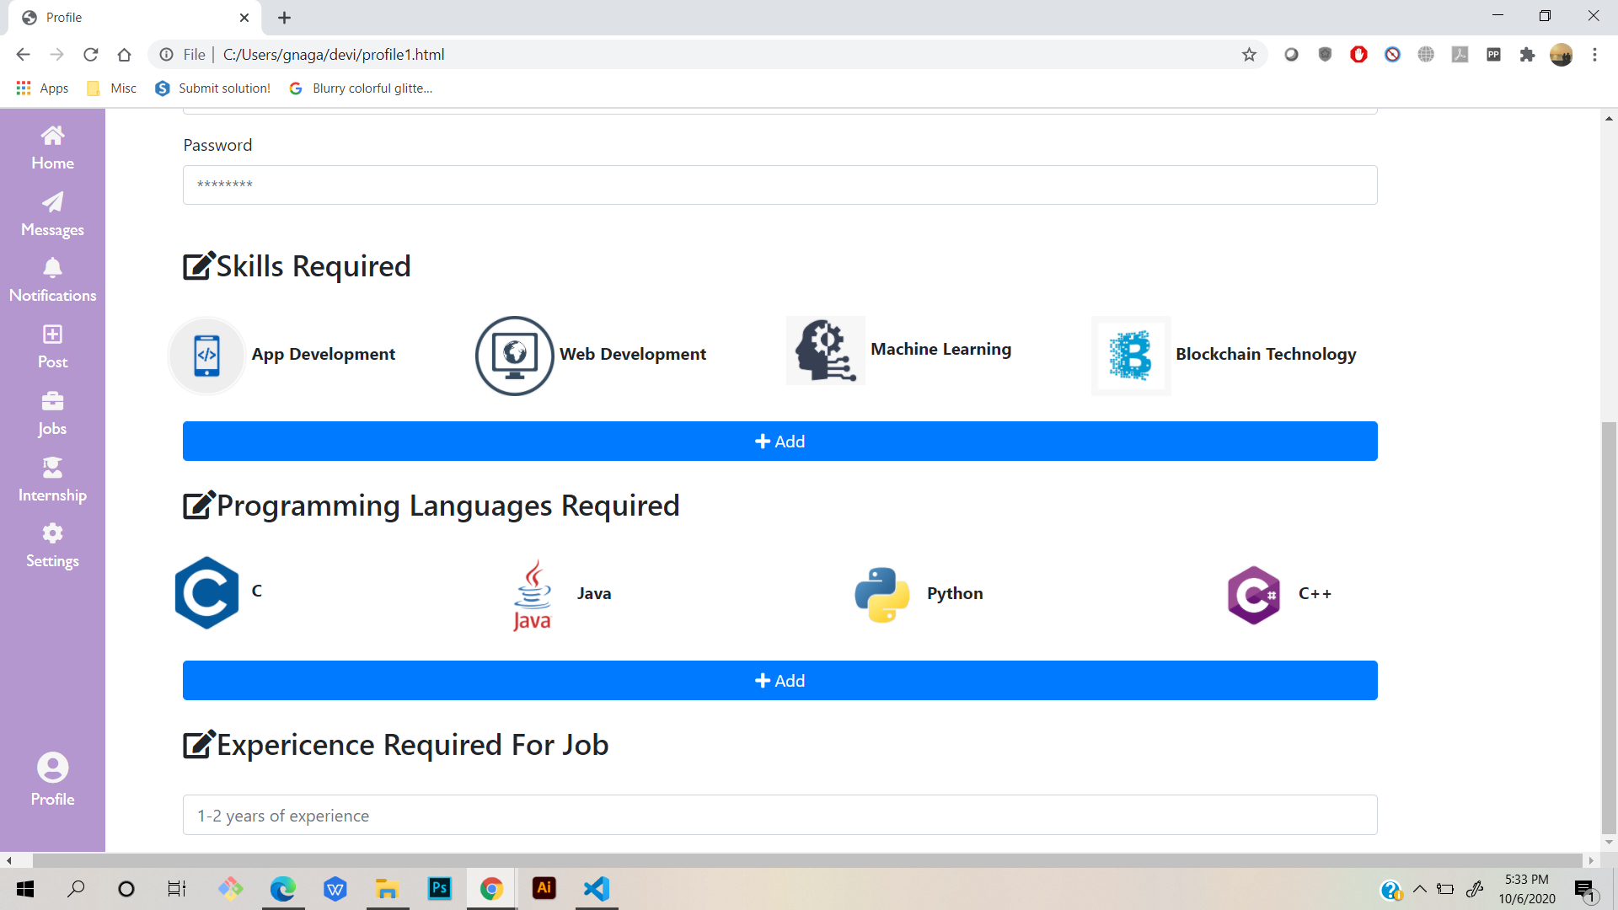
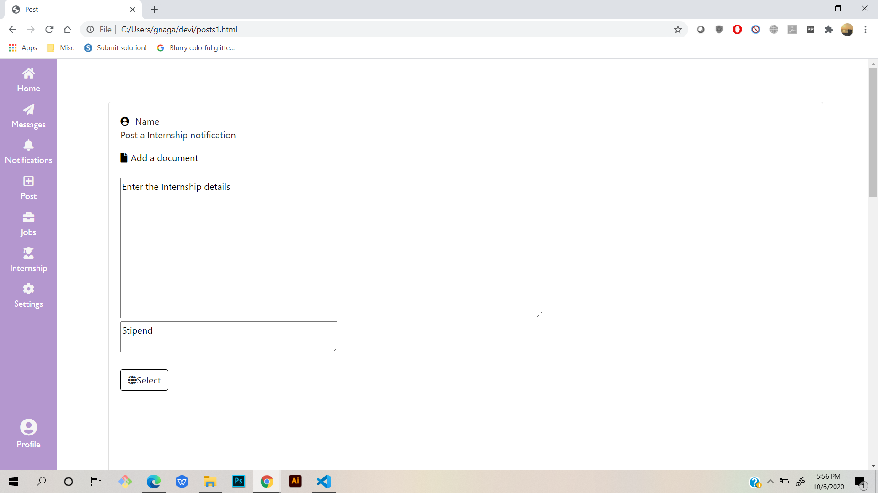
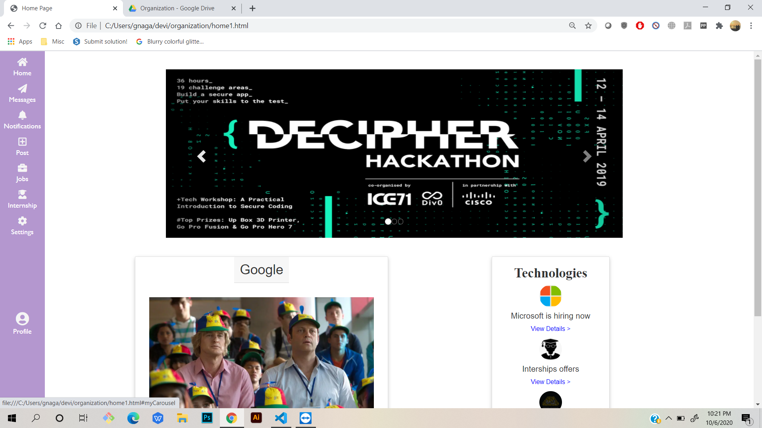
Companies

Slide 8

Students
The next following pages are displayed when the login users are students by the next pages they can find internships & jobs from the companies without interference of thid party.

Slide 9
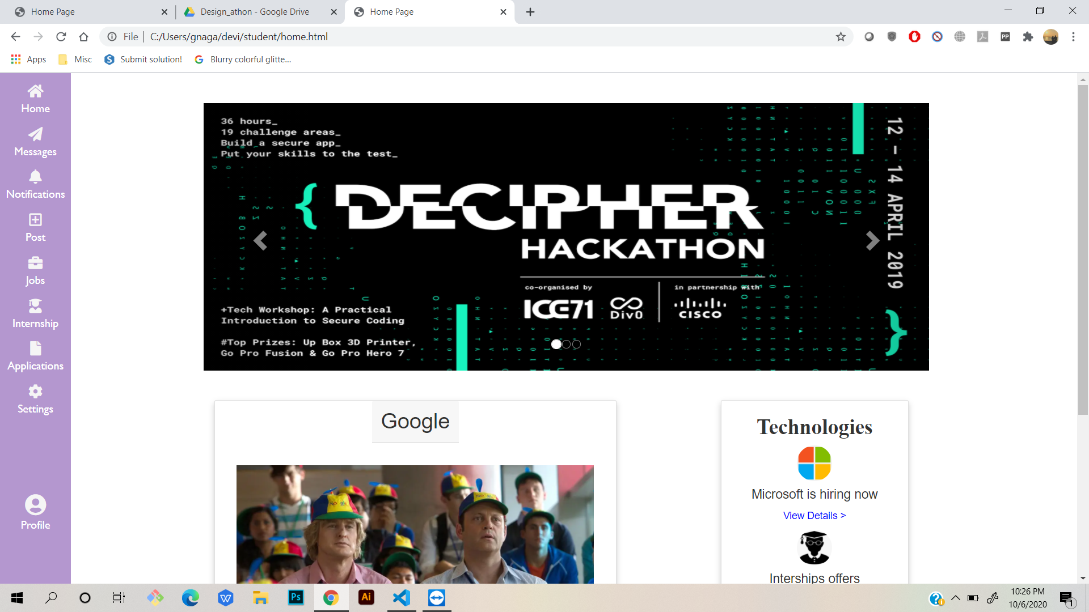
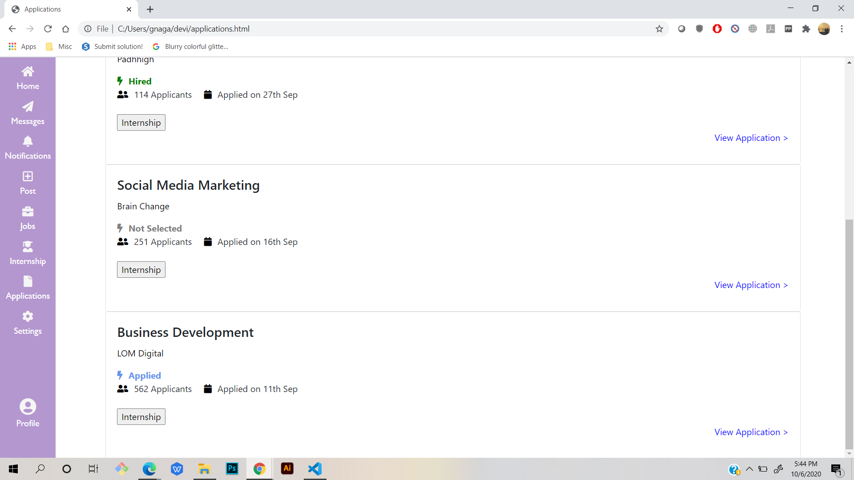
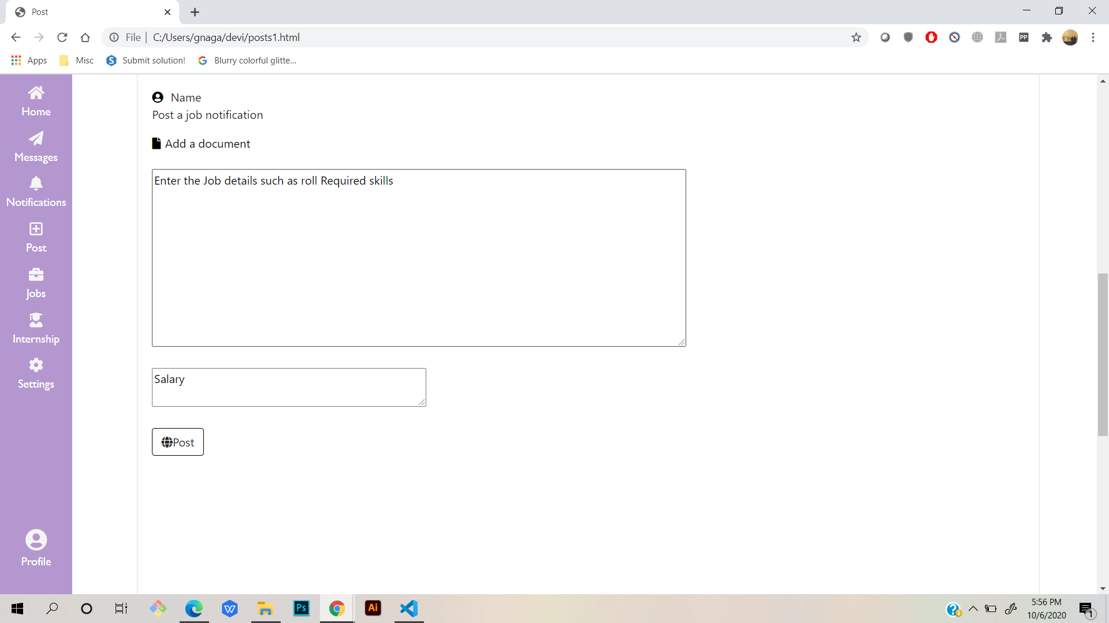
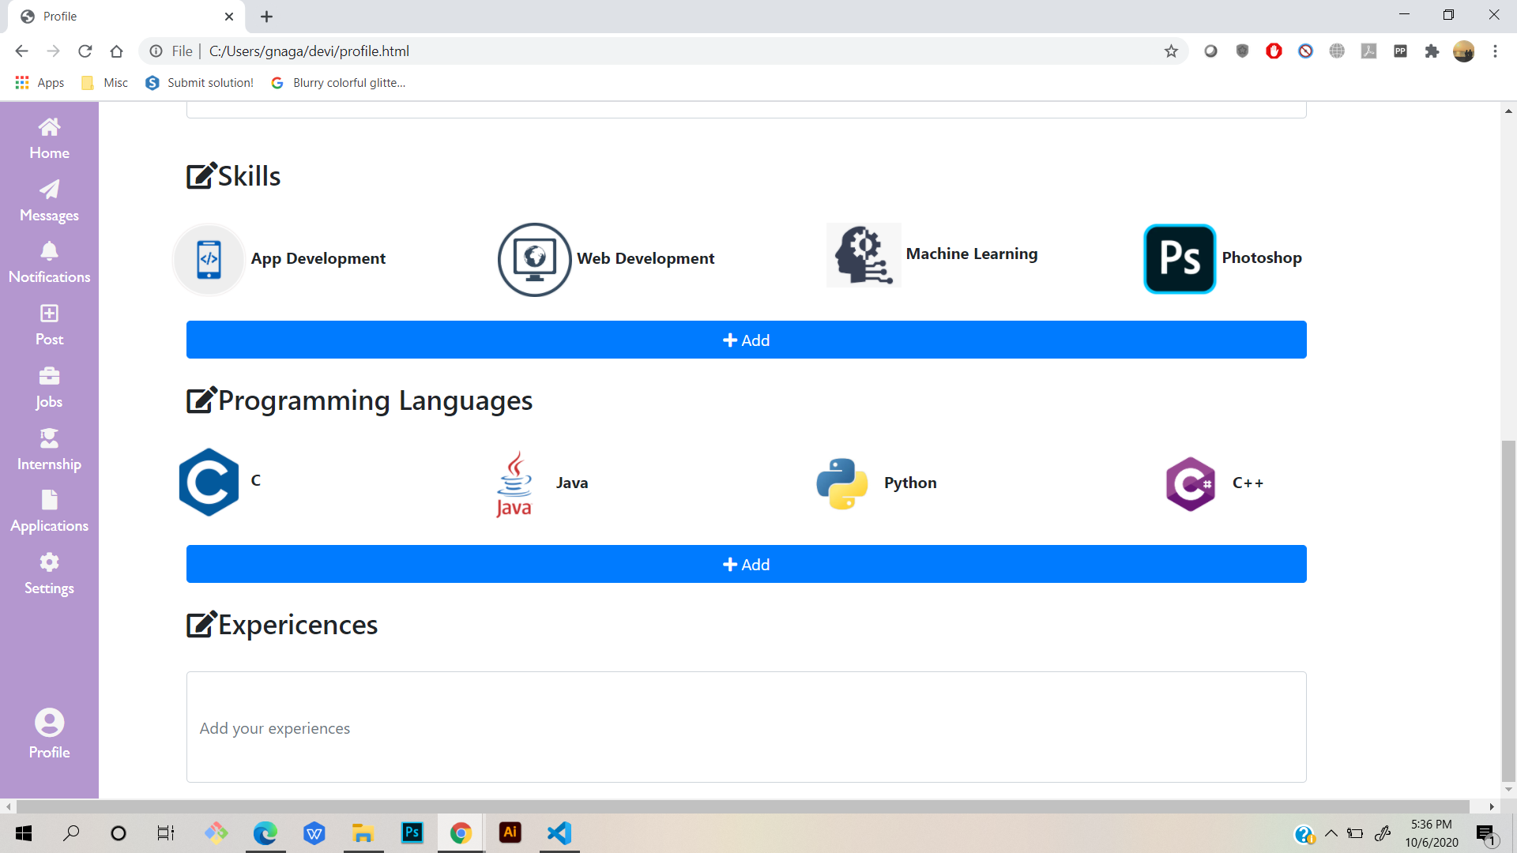
Students

Slide 10

THANK YOU !

